Slide 1
Trending Jobs
Anil jhamb 12110076
chitra Nair 12110058
Deepika rawat 12110074
Namrata Nagaraj 12110045
rohini singh 12110094
Virendra shekhawat 12110040

Slide 2
Recommender system technique- Unsupervised
Scraping
NLP based feature extraction
Database creation of feature sets
R.A.T.S. (Resume Automatic Tracking System) creation
Prediction Model
Automation of candidate matching and skillset recognition

Slide 3
Business & Data Understanding
Minimize recruiting cost
Hiring local candidates
Eliminating consulting cost
Referrals
Creation of database
Cross training
Business problem
Changed working culture has triggered job-cuts
Business objective

Slide 4
Data Preparation
Data collection
candidate profile
Postjobsfree.com-
Data collection
Job profile
As per user input
Data processing
Beautiful soup
Skillset recognition
Term vector creation
Corpus obtained from Kaggle job csv
NLTK
Name Entity Recognition
Kaggle
N-gram matching
Porter stemmer
Match user profiles and job profiles based on skills similarity
Crowdsourcing
Attribute generation and selection
Data integration
Social sites data
Survey data

Slide 5
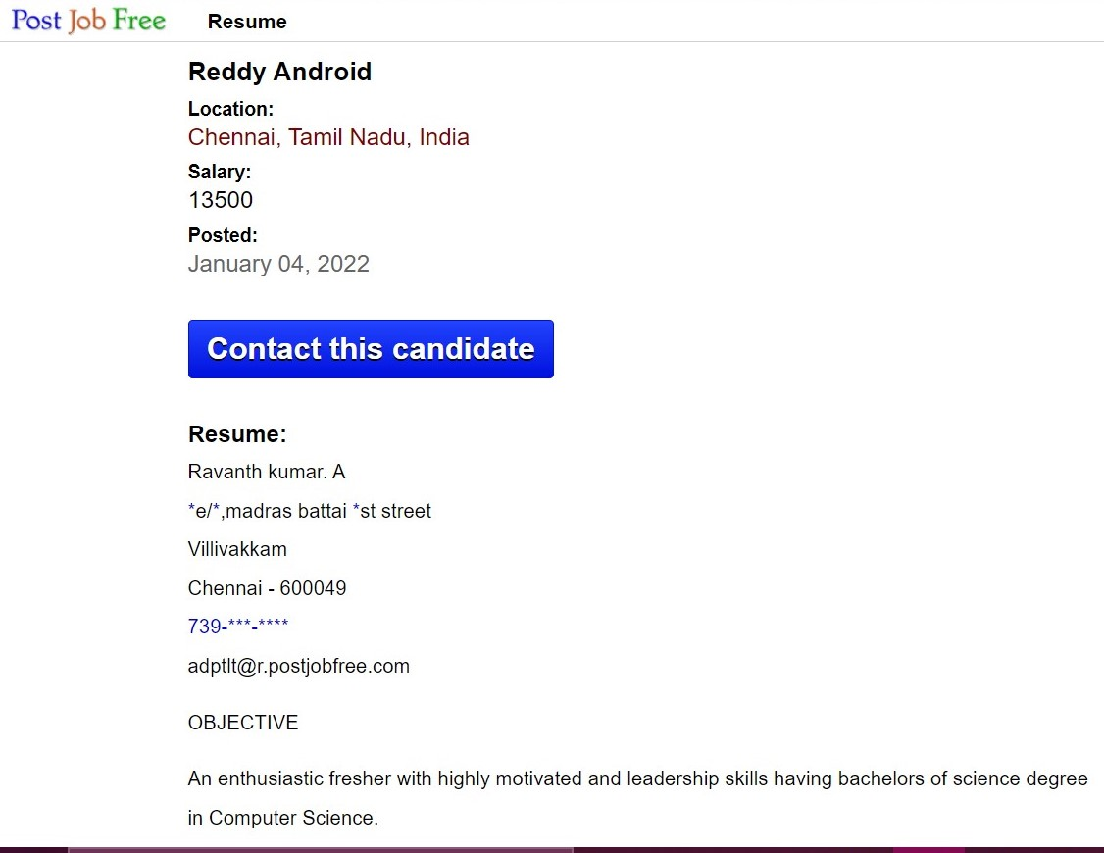
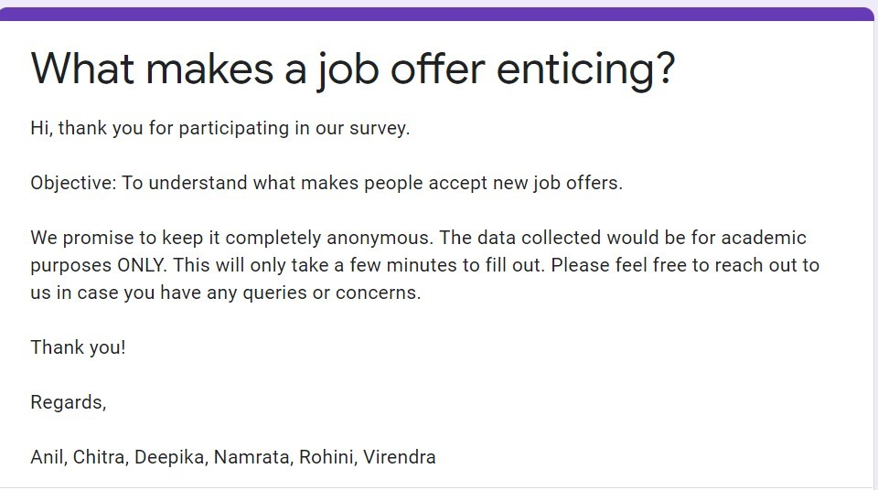
Data sources
Job profiles- postjobsfree.com
Crowdsourcing to enhance the data-
circulated among peer groups
Notes:
Postjobsfree:
https://www.postjobfree.com/resume/adptlt/reddy-android-chennai-tamil
Survey:
https://docs.google.com/forms/d/e/1FAIpQLSdTPnBUCL6UtNjxrXsklBYE_KwSH0W297xB4Oni_wpdceDg/viewform?vc=0&c=0&w=1&flr=0

Slide 6
Data architecture
Data scraping
Collection of documents
Text pre processing
Term matrix creation
User profiles
Calculate similarity
Retrieval
Ranking
Job descriptions
Collection of documents
Text pre processing
Term matrix creation
Information retrieval system

Slide 7
Modelling – Unsupervised- recommender system technique
Job description inputted
Term matrix created- TDM DTM
Cosine similarity of profile and description matrices calculated
Take similarity > 0
Rank based on cosine similarity
NLTK word tokenization Recommender system used to predict relevance of a using query
Text Mining & NLP (Natural Language Processing) tools used- BoW - Bag of Words, TDM / DTM, NLTK word tokenization score calculated
Process first checked against a single query (i.e., skill) and then repeated

Slide 8
Evaluation- Mean average precision
Mean average precision- For a given query, the average precision is calculated. The mean of all the AP scores would give us one MAP which would quantify how good the model is at performing the query
Simple random sample of 20% of the corpus is obtained and Mean average precision calculated
Since the samples are random, the average precision would give a good/unbiased metric
Challenges in evaluation:
Lack of past data
Lack of prior rank
Hence, data could not be split as test and training data
Past data regarding acceptance of an offer is unavailable to us. Hence, supervised methods such as logistic regression for calculating probability of acceptance could not be used

Slide 9
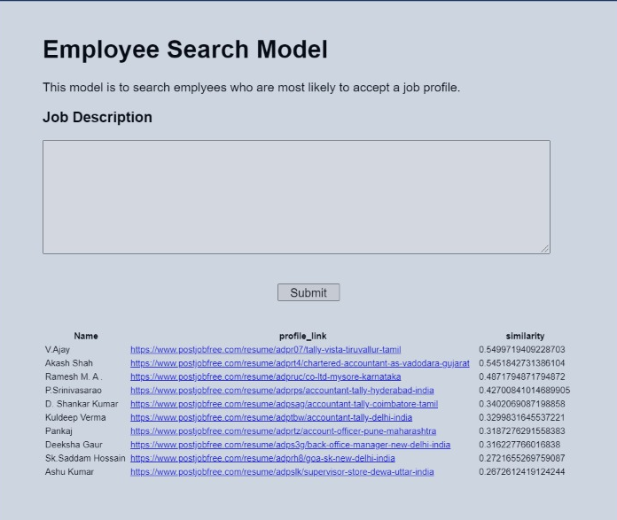
Deployment
Deployment done using a FLASK
Input- job description
Output- ranking of profile similarity

